Slide 1

Department of Computer Science and Engineering CSB4342 – DESIGN PROJECT 2 ZOOM AI SIGN LANGUAGE INTERPRETATION Review-0
G Madhulika Reddy 21113073
Dharshan R E 21113049
SUPERVISORS
Praisy Evangelin A, Professor

Slide 2
Agenda for Review 0
Introduction
Abstract
Literature review
Objective
Architecture diagram
Contribution of Team members
References

Slide 3
Introduction
Zoom AI sign language interpretation aims to integrate artificial intelligence (AI) technology with the Zoom platform to facilitate sign language communication. By leveraging AI algorithms, the system enhances the interpretation and understanding of sign language during Zoom meetings, making them more accessible and inclusive for individuals who are deaf or hard of hearing. Through real-time interpretation and communication support, this project seeks to bridge communication gaps and promote equal participation in virtual meetings and discussions.

Slide 4
Abstract
Problem: The lack of widely available sign language interpretation tools creates communication barriers for the Deaf and hard-of-hearing community.
Existing sign language interpretation solutions often have limited accuracy, require specialized hardware, or fail to capture the nuances of natural sign language.
Proposed solution: Our project develops a real-time sign language interpretation system utilizing computer vision and deep learning techniques for improved accessibility.
Methods/Components: AI, computer vision technology, and hardware setup with cameras to detect hand movements and landmarks.
Justification: This solution aims to provide cost-effective, real-time sign language interpretation on standard devices, promoting inclusion and accessibility.

Slide 5
Literature review/Existing Systems
S.No | Title of the paper/System | Authors | Publication (Name of the Journal/Conference proceedings with Year) | Algorithm/Methodology adopted | Limitations
1. | Review paper on sign language recognition for the deaf and dumb | R. Rumana ,& R . Prema | International Journal of Engineering Research & Technology (IJERT), 2023 | Analyze video using hand detection, feature extraction and classification with traditional machine learning. | Accuracy:80% Often lack sufficient data for less common signs or regional variations within sign languages
2. | Accuracy Enhancement of Hand Gesture Recognition Using CNN | Gyu Tae Park , & V. K Chandrasekar | Institute of Electrical and Electronics Engineers Journal(IEEE), 2023 | Utilizing CNN architecture with diverse datasets and optimized training techniques enhances hand gesture recognition accuracy. | Variability in hand gestures Limited dataset diversity

Slide 6
Literature review/Existing Systems
S.No | Title of the paper/System | Authors | Publication (Name of the Journal/Conference proceedings with Year) | Algorithm/Methodology adopted | Limitations
3. | Deep Learning-Based Standard Sign Language Discrimination | Menglon Zhang ,& Min Zhao | Institute of Electrical and Electronics Engineers Journal(IEEE), 2023 | The FGSFP+TFFR was fine-tuned with pretrained key frame detection model. The DCSR3D+ GRU model was designed to realize comprehensive correctness discrimination of the sign language category and standardization. | Small datasets make it difficult for models to learn complex patterns. Imbalances in the dataset can lead to biased recognition results.
4. | Dynamic Korean Sign Language Recognition | Jung Pil Shin ,& A.S. Musa ,& K. Suzuki | Institute of Electrical and Electronics Engineers Journal(IEEE), 2023 | GCN and an attention-driven neural framework, resulting in a robust and effective model for dynamic Korean Sign Language (KSL) recognition | Small KSL datasets hinder the model's ability to learn and adapt to a wide range of signing variations.

Slide 7
Literature review/Existing Systems
S.No | Title of the paper/System | Authors | Publication (Name of the Journal/Conference proceedings with Year) | Algorithm/Methodology adopted | Limitations
5. | American Sign Language Words Recognition Using Spatio-Temporal Prosodic and Angle Features: A Sequential Learning Approach | B.A. Sunusi & C. Kosin | Institute of Electrical and Electronics Engineers Journal(IEEE), 2022 | FFV-Bi-LSTM to train 3D hand skeletal information of motion and orientation angle features learned from the leap motion controller (LMC). | FFV is trial and error strategy while choosing stable GMM components.
6. | Sign Language Recognition via Late Fusion of Computer Vision and Leap Motion | Jordan J. Bird 1, Anikó Ekárt and Diego R. Faria | Multidisciplinary Digital Publishing Institute(MDPI), 2022 | Computer Vision Feature Extraction and Leap Motion Data Acquisition Late Fusion Integration and Gesture Classification | Limited Leap Motion Range Environmental factors affect accuracy

Slide 8
Literature review/Existing Systems
S.No | Title of the paper/System | Authors | Publication (Name of the Journal/Conference proceedings with Year) | Algorithm/Methodology adopted | Limitations
7. | Real Time Sign Language Interpreter | G.N. Geethu ,& C.S. Arun | International Journal on Electrical, Instrumentation and Communication Engineering, 2022 | Hand sign recognition system was implemented using ARM CORTEX development board. | Low-resolution images or inconsistent signing can impact accuracy.
8. | A Review of the Hand Gesture Recognition System | Noraini Mohamed ,& Nazean Johmar | Institute of Electrical and Electronics Engineers Journal(IEEE), 2021 | Histogram of Oriented Gradient (HOG), Convolutional Neural Network (CNN), and Principal Component Analysis (PCA). | It needs to work with sign variations. It is difficult to be addressed in practice.

Slide 9
Literature review/Existing Systems
S.No | Title of the paper/System | Authors | Publication (Name of the Journal/Conference proceedings with Year) | Algorithm/Methodology adopted | Limitations
9. | Intelligent Sign Language Recognition Using Image Processing | Sawant Pramada, & Nerkar Samiksh,& S. Vaidya | IOSR Journal of Engineering (IOSRJEN) , 2021 | Image Processing and Template matching for better output generation. | These systems may not be able to recognize all signs, especially rare or regional signs.
10. | Sign Language Recognition Using Deep Learning and Computer Vision | Dr. Sabeenian R.S | Journal of Advanced Research in Dynamical and Control Systems, 2021 | A CNN based approach for the recognition and classification of the sign language using computer vision. | It doesn’t support background subtraction when the frames are dropped from a video.

Slide 10
Objective
To utilize MediaPipe for efficient and accurate hand detection an
To Train a deep learning model to perform robust sign classification on the hand landmarks extracted by MediaPipe.
To Integrate the sign classification model with a language translation module to produce real-time spoken language outpu
To Bridge communication gaps between hearing and non-hearing participants in virtual meetings.
To Promote inclusivity and equal participation in Zoom discussions for all users, regardless of hearing ability.

Slide 11
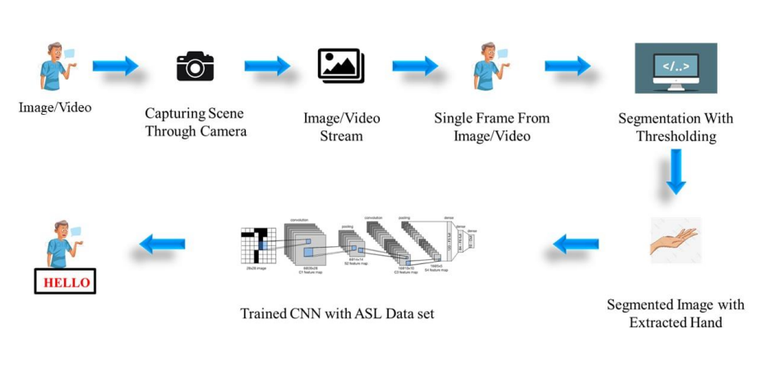
ARCHITECTURE DIAGRAM

Slide 12
Methodology
Collect or obtain a diverse video dataset of individuals performing signs in the target sign language.
Utilize MediaPipe to extract hand landmarks, representing key points on the hand, from video input.
Select a suitable deep learning architecture for sign classification and train it on the prepared hand landmark data.
Create a user-friendly interface that displays the video or hand visualization alongside the interpreted text in real-time
Assess the system's performance using metrics like accuracy, speed, and user feedback.

Slide 13
References
References:
"Real-time hand gesture recognition using a depth sensor" by Mohamed E. K. Soliman and Mohamed S. Kamel, published in the Journal of Ambient Intelligence and Humanized Computing in 2021.
"A review of hand gesture recognition techniques for human-computer interaction" by Xiaofei Du, Xinghao Chen, and Yulong Dong, published in the Journal of Visual Communication and Image Representation in 2021.
"Deep learning for hand gesture recognition: A survey" by Ahmed Elgammal and Rania Ibrahim, published in the IEEE Access journal in 2021.
"Hand gesture recognition using deep learning: A survey" by S. Suresh, A. K. Singh, and R. K. Singh, published in the Journal of Ambient Intelligence and Humanized Computing in 2022.
"Hand gesture recognition using convolutional neural networks" by Wei-Chih Hung, Yu-Ting Chen, and Jyh-Cheng Chen, published in the Journal of Ambient Intelligence and Humanized Computing in 2021.
"MediaPipe: A Framework for Perceptual Computing" by Google Research, 2021.
Reference books:
"Mastering OpenCV 4 with Python: A practical guide covering topics from image processing, augmented reality to deep learning with OpenCV 4 and Python 3" by Alberto Fernández Villán
"OpenCV with Python By Example" by Prateek Joshi
"Learning OpenCV 4 Computer Vision with Python 3" by Joseph Howse

Slide 14
THANK YOU

